Slide 1
DevOps Workshop, Part II

Slide 2
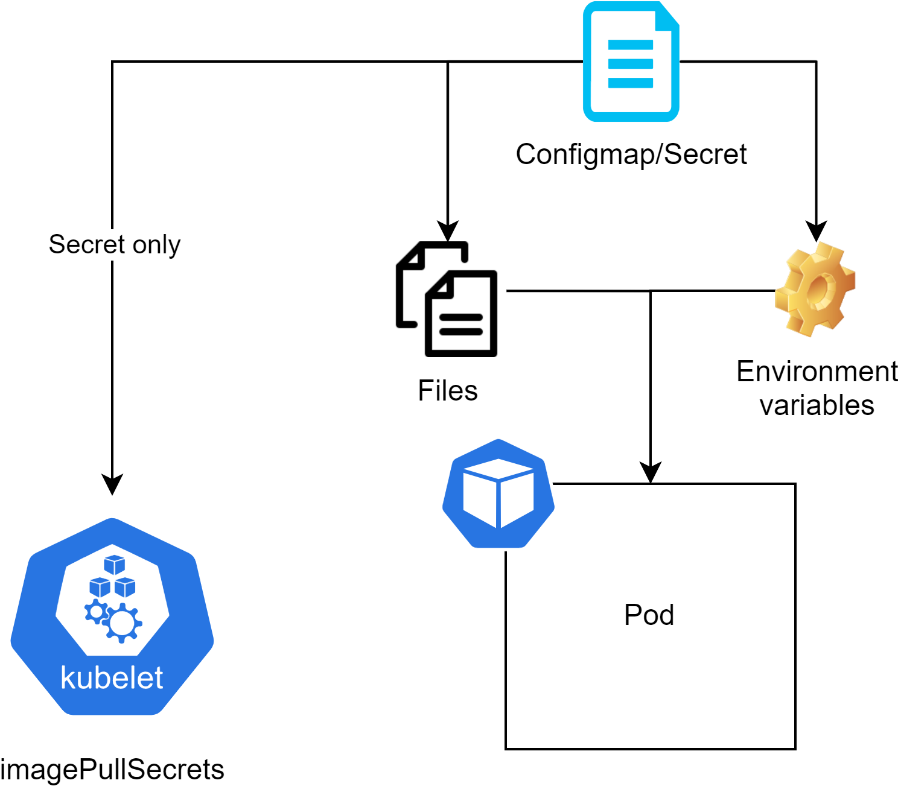
Configmaps & Secrets

Slide 3
Secret types
Built-in Type | Usage
Opaque | arbitrary user-defined data
kubernetes.io/service-account-token | ServiceAccount token
kubernetes.io/dockercfg | serialized ~/.dockercfg file
kubernetes.io/dockerconfigjson | serialized ~/.docker/config.json file
kubernetes.io/tls | data for a TLS client or server

Slide 4
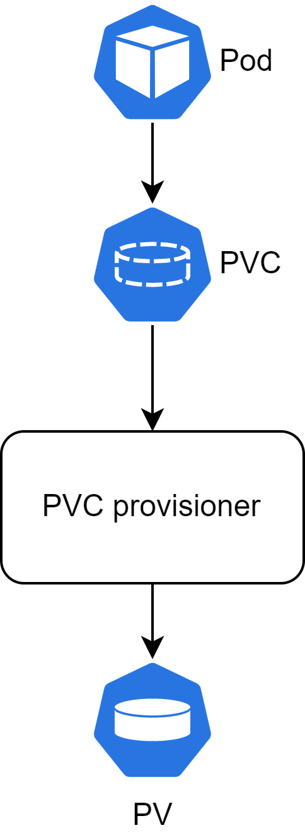
PV(C)

Slide 5
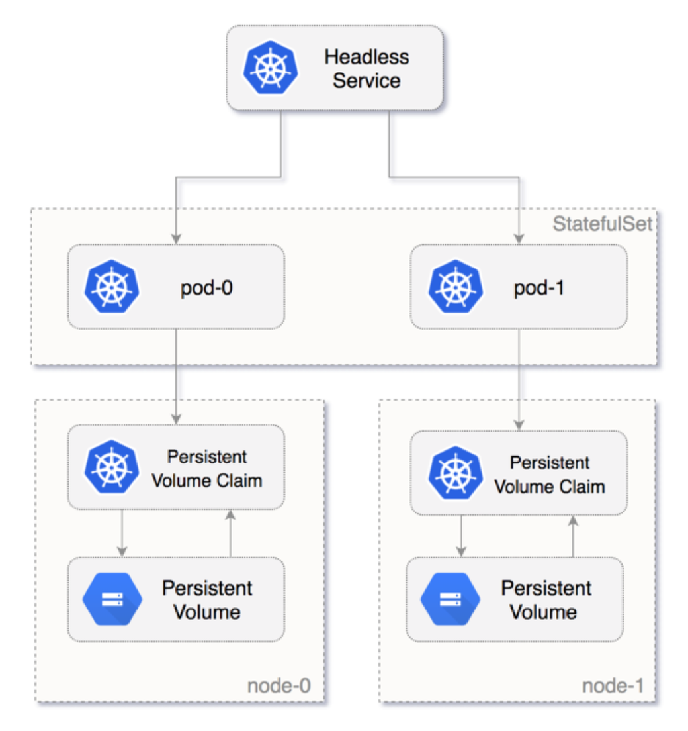
Stateful Sets

Slide 6
Stateful Sets DNS
Cluster Domain | Service (ns/name) | StatefulSet (ns/name) | StatefulSet Domain | Pod DNS | Pod Hostname
cluster.local | foo/nginx | foo/web | nginx.foo.svc.cluster.local | web-{0..N-1}.nginx.foo.svc.cluster.local | web-{0..N-1}

Slide 7
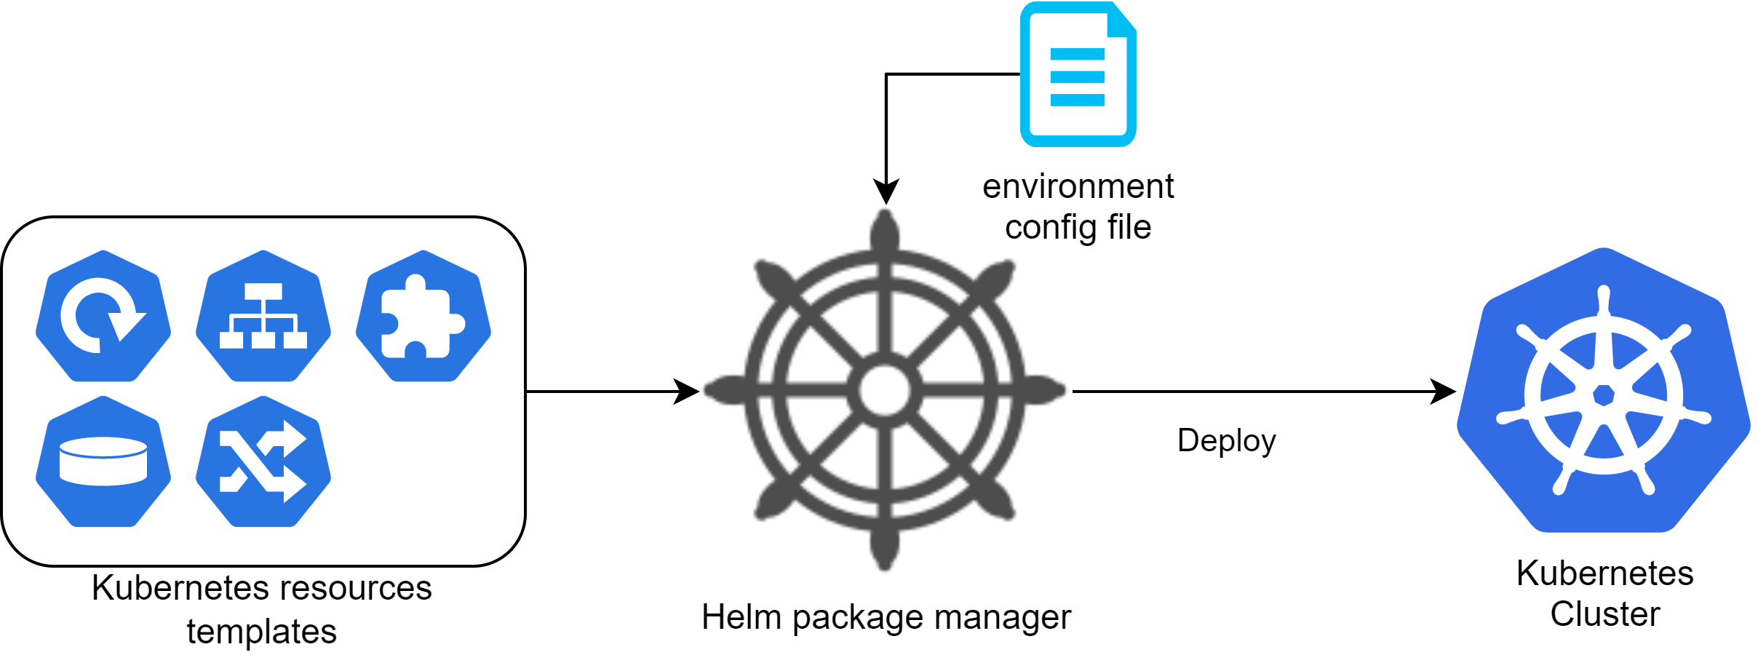
HELM

